Slide 1

FOREX RISK MANAGEMENT THRU OPTION INSTRUMENT
FXMETHODS

Slide 2
An option is a contract which conveys to its owner, the holder, the right, but not the obligation, to buy or sell an underlying asset or instrument at a specified strike price on or before a specified date, depending on the style of the option.

Slide 3
EVERY FINANCIAL INSTRUMENTS INHERENT RISK

Slide 4
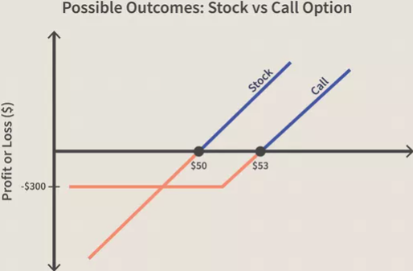
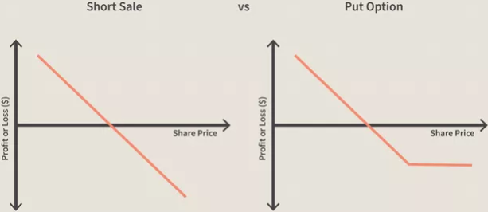
TYPE OF OPTION
CALL OPTION - A call option is a contract that gives the option holder the right to purchase securities at a specified price on or before the option's maturity date.
PUT OPTION - A put or put option is a financial market derivative instrument that gives the holder the right to sell an asset, at a specified price, by a specified date to the writer of the put. The purchase of a put option is interpreted as a negative sentiment about the future value of the underlying stock.

Slide 5
OPTION STYLE
American option is a style of options contract that allows holders to exercise their rights at any time before and including the expiration date.
European option is a version of an options contract that limits execution to its expiration date. In other words, if the underlying security such as a stock has moved in price, an investor would not be able to exercise the option early and take delivery of or sell the shares.

Slide 6
OPTION DRIVING ELEMENT
SPOT PRICE
STRIKE PRICE
EXPIRY DATE
VOLATILITY
INTEREST RATE

Slide 8
FX OPTION MARKET

Slide 10
OPTION PROS & CONS
PROS
CONS
Cost Efficient
High Return Potential
Lower Risk
More Strategy Available
Leverage
Time Decay
Volatility

Slide 11
Time Decay
Time decay is a measure of the rate of decline in the value of an options contract due to the passage of time. Time decay accelerates as an option's time to expiration draws closer since there's less time to realize a profit from the trade.
Time decay is the reduction in the value of an option as the time to the expiration date approaches. An option's time value is how much time plays into the value—or the premium—for the option.

Slide 12
TRADE PROCESS COMPARISION

